Slide 1
Azure Storage Queue
Anastasia Belokurova

Slide 2
Azure storage intro
Table Storage
Blob Storage
Storage Queue
File Storage

Slide 3
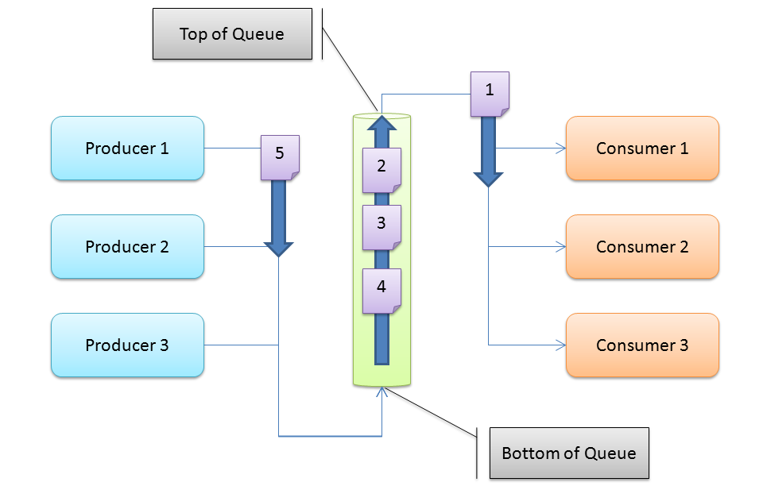
Queue Terminology

Slide 4




Message lifecycle
RemoveMessage
GetMessage (Timeout)
PutMessage
Queue
Worker Role
Msg 1
Msg 2
Msg 2
Web Role
Msg 1
Msg 3
Msg 4
Worker Role
Worker Role
Msg 2

Slide 5
Demo

Slide 6
Pricing
Storage Capacity | Locally Redundant Storage (LRS) | Geographically Redundant Storage (GRS) | Read-Access Geographically Redundant Storage (RA-GRS)
First 1 TB / Month | $0.07 per GB | $0.095 per GB | $0.12 per GB
Next 49 TB / Month | $0.065 per GB | $0.08 per GB | $0.10 per GB
Next 450 TB / Month | $0.06 per GB | $0.07 per GB | $0.09 per GB
Next 500 TB / Month | $0.055 per GB | $0.065 per GB | $0.08 per GB
Next 4,000 TB / Month | $0.045 per GB | $0.06 per GB | $0.075 per GB

Slide 7


Slide 8
Thank you
Skype: Anastasiia.belokurova
Email: anastasiia.bel@gmail.com

